Slide 1
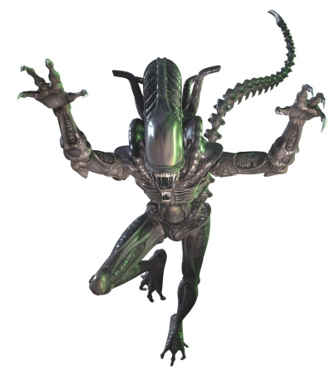
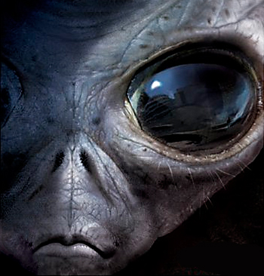
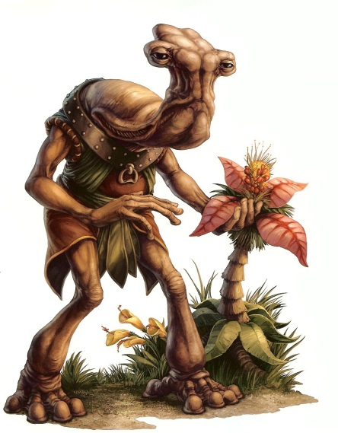
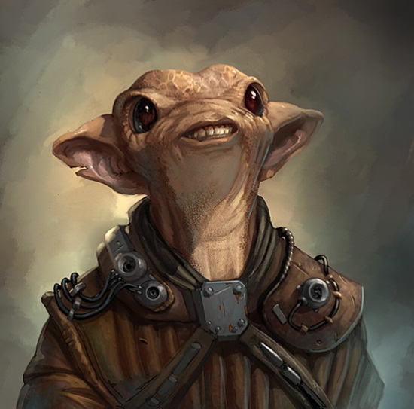
Life in the Universe
Are We Alone in the Vast Cosmos?

Slide 2
The Questions?
Is there intelligent life on our planet?
Is there intelligent life out there?
Are we alone?
How can we find them if they are there?
Would they be looking for us?
Does it really matter if we are the only intelligent life in the universe?
What are the odds we are alone?

Slide 3
Is there intelligent life on our planet?
While this seems like a silly question, think back to our theories on what the universe is.
If it is all a dream or a computer generated world, then this is all fiction.
We must make the assumption that we are real, but are all the things we are being taught true.
As you will learn Truth, reality, and what we think to be correct are often not the same.

Slide 4
Assuming we are real, then you must define “Intelligent Life.”
Intelligent Life - showing or resulting from an ability to think and understand things clearly and logically
The real question is, are humans the only intelligent life on Earth?
We would like to think so, but as we continue to study all life on Earth, that line gets a bit fuzzy at times, and many groups declare that we are not.

Slide 5
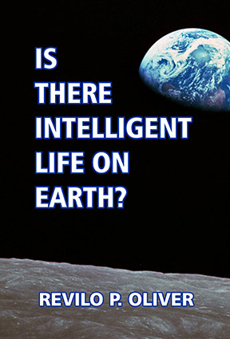
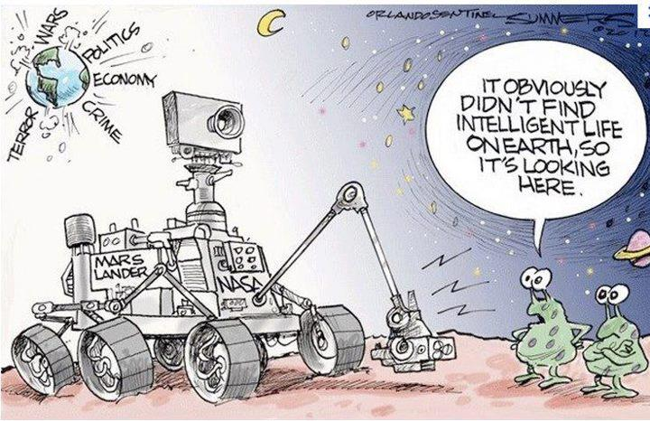

Slide 6
Is there intelligent life out there?
As of now, we have no idea, but the prevailing answer is… at this time we have not found any.
That certainly keeps the door open to keep searching in the hope that there is.
We have not officially found indisputable proof of life of any kind other than on our planet.
There have been reports of microbes on Venus, but that may be from large explosions on Earth scattering dead cells across the solar system.

Slide 7
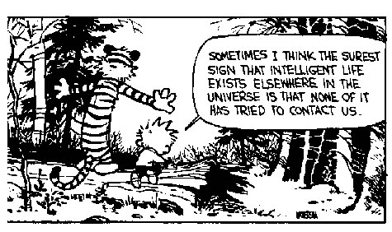
It could be that we are incapable of finding others, we do have a limited view and limited technology.
It could be that we are not looking in the right place. It would be like looking for a needle in a haystack, but not knowing if there is a needle there at all.

Slide 8
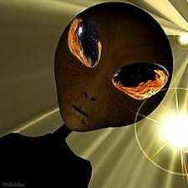
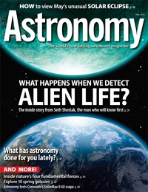

Slide 9
Are we alone in the cosmos?
So far it appears we are, although it depends on how you define alone.
Are there other realms of existence and consciousness that we cannot perceive?
Are there other space time continuums that are out of phase with ours?

Slide 10
Is there a spirit world, and are there spirits and demons out there that we cannot quite comprehend, but are active on this world?
It seems like a lot of empty space if we are alone.
What if they are in a different galaxy, right now it would be difficult to find them considering the large distances between galaxies.

Slide 11
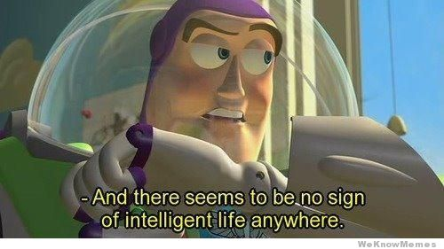

Slide 12
How can we find them if they are there?
We are always looking.
SETI (Search for Extraterrestrial Intelligence) is a government program that is constantly monitoring the heavens for incoming transmissions, and sending our own out in an attempt to make contact.

Slide 13
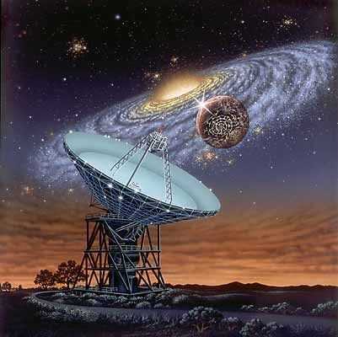
Would they be looking for us?
Maybe or maybe not.
This would depend on their level of technology, their desire to find others in the universe, and their definition of intelligent life.

Slide 14
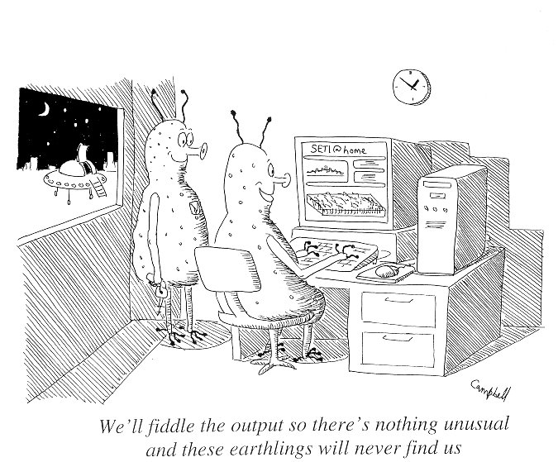

Slide 15
Does it really matter if we are the only intelligent life in the universe?
Some say yes, and some say no.
Some say it would destroy all religious views.
Some say it would confirm all religious views.
Some say they may be hostile.
Some say we are the hostile ones and they would not want to find us.
Some say it would either confirm or blow up evolutionary theories.

Slide 16
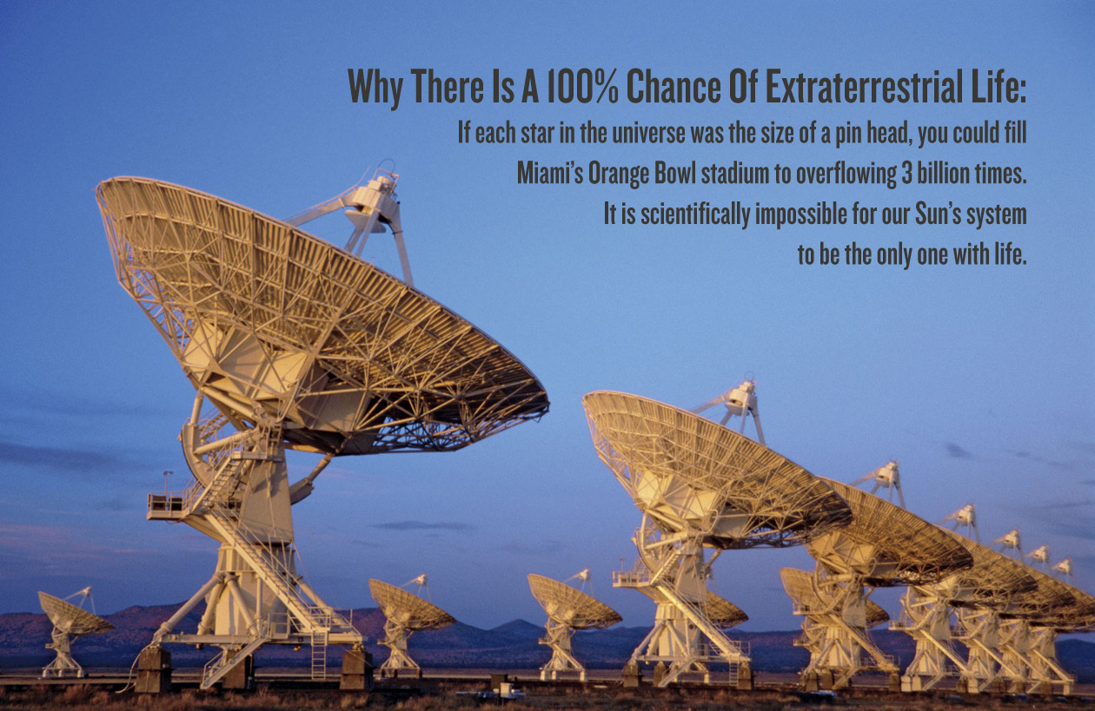
What are the odds we are alone?
This depends on your viewpoint.
From the viewpoint of space and stuff out there…

Slide 17
From an evolutionary viewpoint, of random chance molecules and exact perfect conditions for life to begin….very low.
The famous Drake equation has led scientist to many times calculate the odds…
Even if there are only three or four civilizations per galaxy, there are billions and billions of galaxies. With each galaxy having potentially billions of solar systems and planets
Drake Calculation video

Slide 18
Where do we go from here?
We are constantly searching and that will most likely not stop anytime soon.
Will a Star Trek or a Star Wars type galaxy be reality in the future or our planet, who is to say. Maybe.
Think about all the changes that would need to occur.

Slide 19
